Slide 1

Assistive Technology Wins
Brainstorm 2020

Slide 2
HELLO!
Emily Kom - SLP/AT Consultant
Claire Habeck - AT Consultant
Duane Retzlaff - Technology Support
Oshkosh Area School District
10,000 students
22 Schools

Slide 3
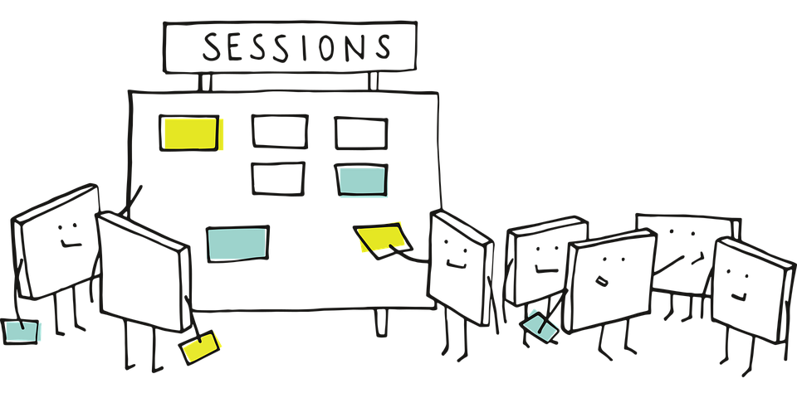
Learn from Us
Not fixing equipment, but fixing access
Understanding each other's duties and goals
How we can work together

Slide 4
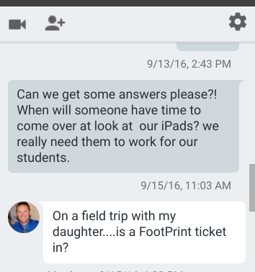

Frustrations
Perceptions
  Not Important
  Uninterested
  Talk to the hand
  Ticket

Slide 5

Misconceptions
Different perspectives and priorities
Lack of communication/collaboration
AT’s push for self-reliance and eliminating roadblocks to student access
IT workload, lots of work for smaller number of students, what’s attainable

Slide 6
For people without disabilities technology makes things easier. For people with disabilities, technology makes things possible.
-Ibm training manual 1991

Slide 7
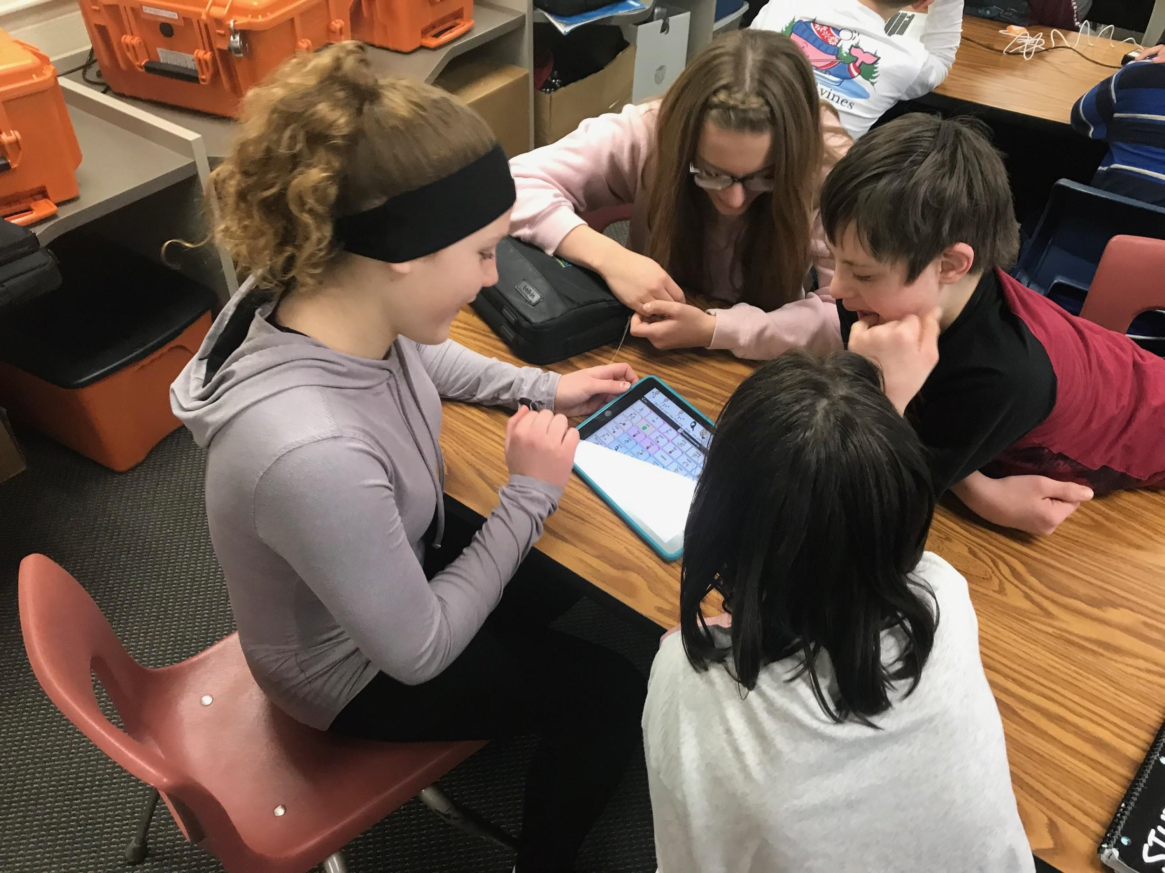
Finding Solutions
Our journey took many directions, ultimately leading us towards purposeful collaboration, efficient processes, and improved outcomes for students with disabilities.

Slide 8


Expectations
Understand Perspectives
Improve Communication
Understand Capabilities

Slide 9
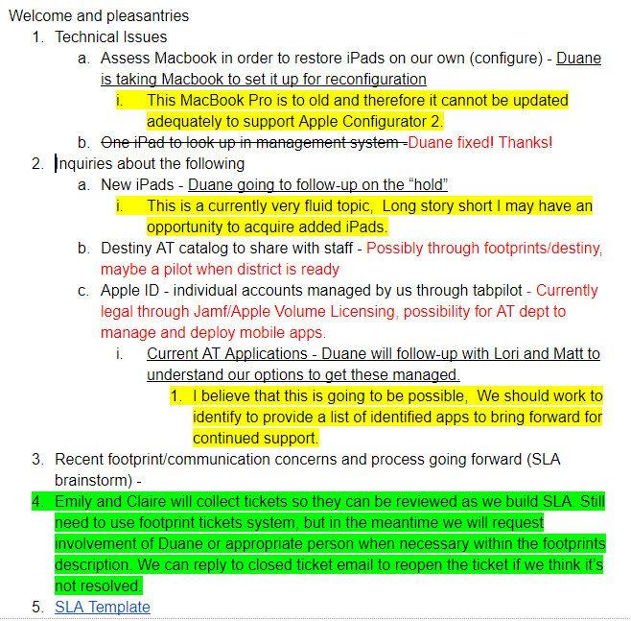
Listen
Meet regularly
  Develop agenda
  Effective collaboration
  Understand common goals
  Work through challenges

Slide 10

Changes
District moving away from iPad usage
AT’s increase in iPad usage
Inventory process
Management apps - Apple ID

Slide 11
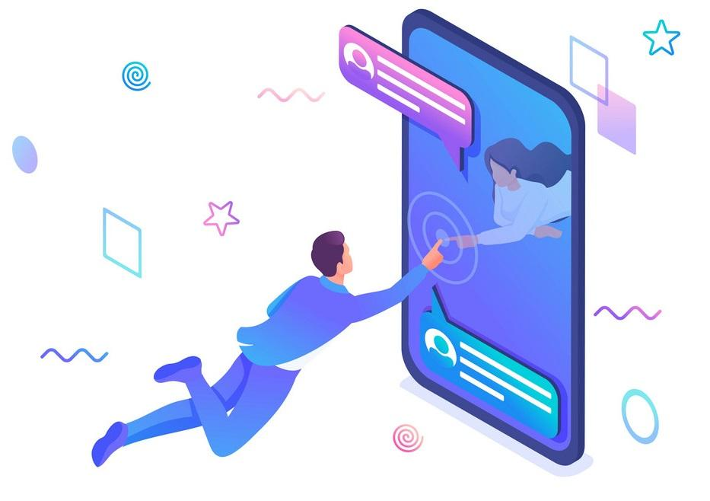
Possibilities
iPad Management
  TabPilot
  Enhanced access to jamf
  Alternative inventory system for AT equipment

Slide 12
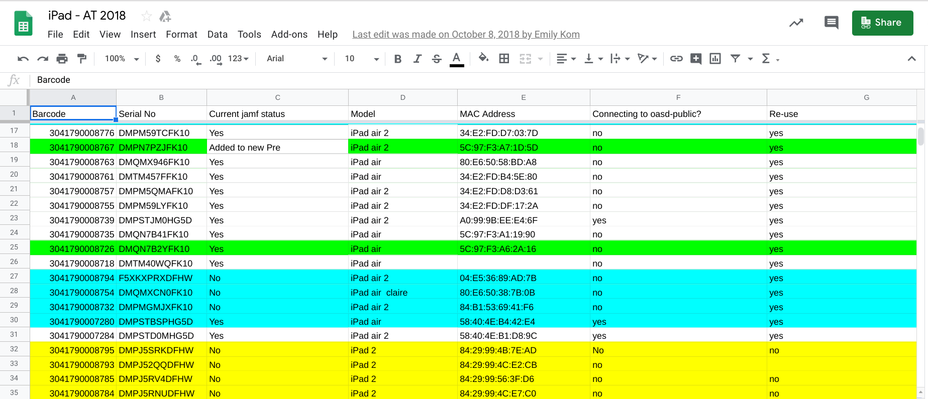
AT iPad Clean-Up

Slide 13

Results
New use for older iPads
Manage new iPads
Improve ability to manage App deployment
Standardized inventory

Slide 14
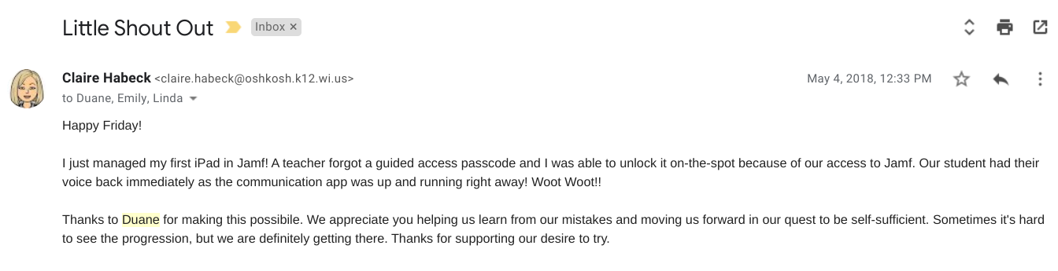
Self-Reliance

Slide 15
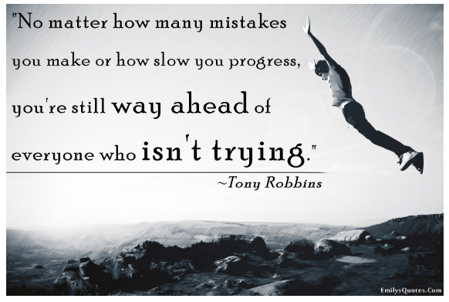
Determination

Slide 16
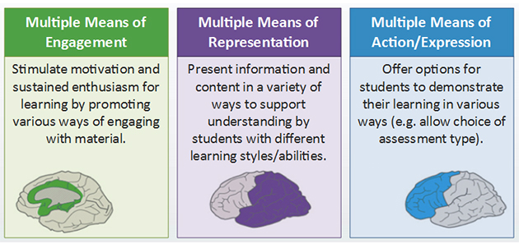
Future
Universal Design for Learning (UDL)
AT collaboration with district tech teams/curriculum to ensure access for all
High/Low Incident needs

Slide 17

Future
Equity and inclusion push technology innovation
Google Voice Recognition - Down Syndrome
Ford’s Feel the View Window for blind
Ed tech that meets the needs and learning styles of all students - Universal Design for Learning

Slide 18
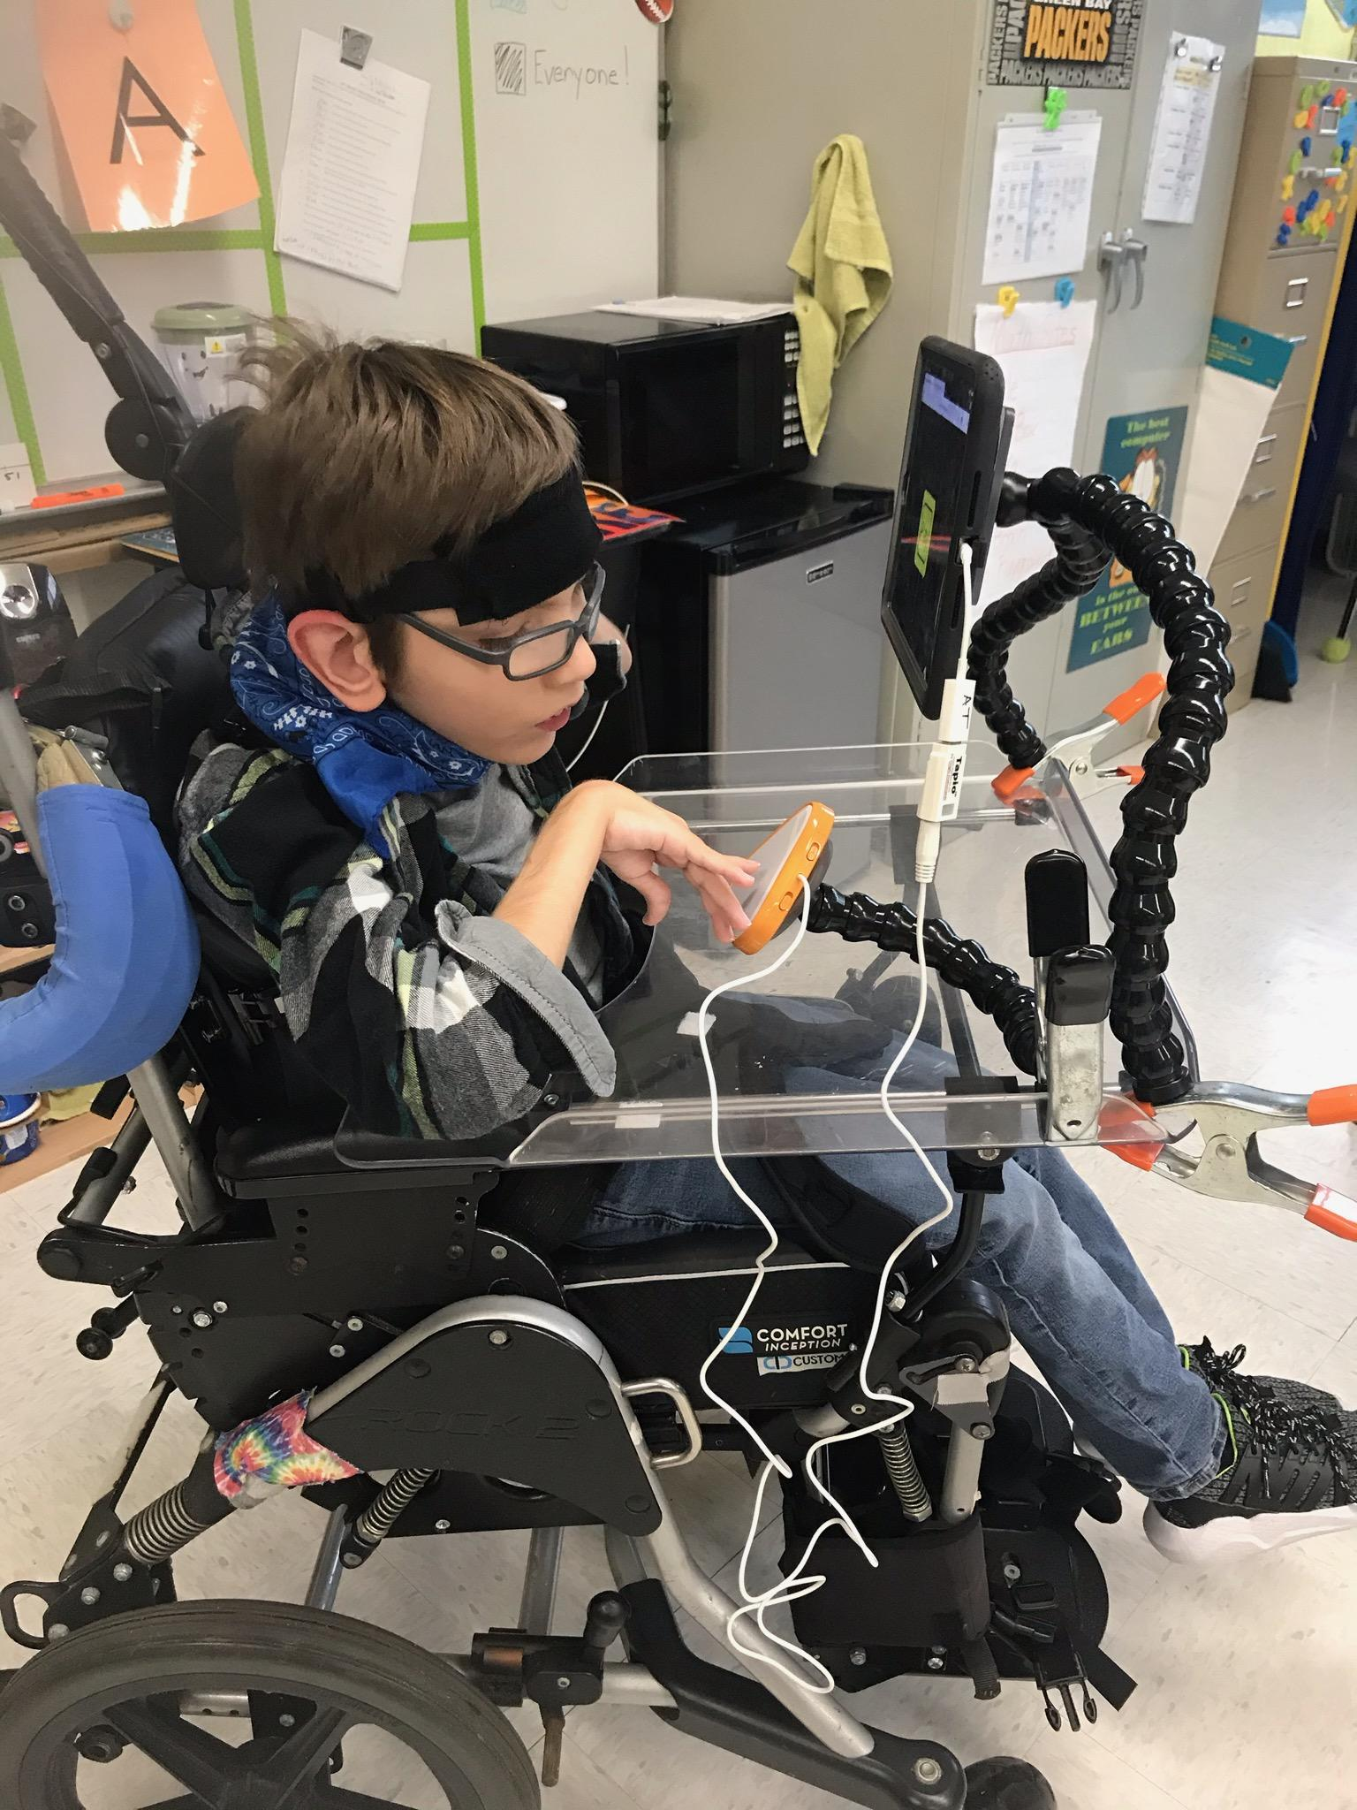
WIN
Technology stayed in the hands of students who needed it most

Slide 19
THANKS!
Any questions?
You can find us at:
emily.kom@oshkosh.k12.wi.us
claire.habeck@oshkosh.k12.wi.us
duane.retzlaff@oshkosh.k12.wi.us

Slide 20
CREDITS
Special thanks to all the people who made and released these awesome resources for free:
Presentation template by SlidesCarnival
Photographs by Unsplash

